Slide 1
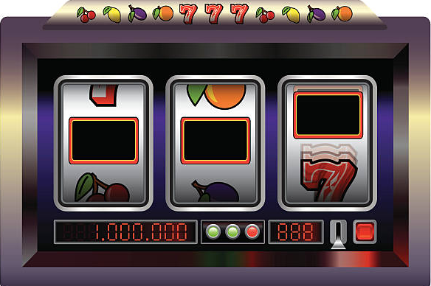
Sports video games and gambling addiction, two parallels? Not in the EA FC series.
By: Kenneth Ibarra Suarez

Slide 2
Literature Review
RHSA Roads-To-Research 2024-2025 Academic year.
Fields of study involved: Psychology, Computer Science, Education, Economics, Health, etcetera.
Internet Gaming Disorder (IGD)
Officially recognized by World Health Organization (WHO)
Diagnosed if 5/9 behaviors or more
Very similar to a drug addiction
Gambling Addiction
Compulsive and uncontrollable gambling behavior
Positive correlation with IGD
Bridge = “Loot Boxes”
Randomized rewards or “loots”
Bought with in-game currency or real money
Leads to more “microtransactions”
Called “packs” in FIFA
Gambling Addiction
IGD

Slide 3
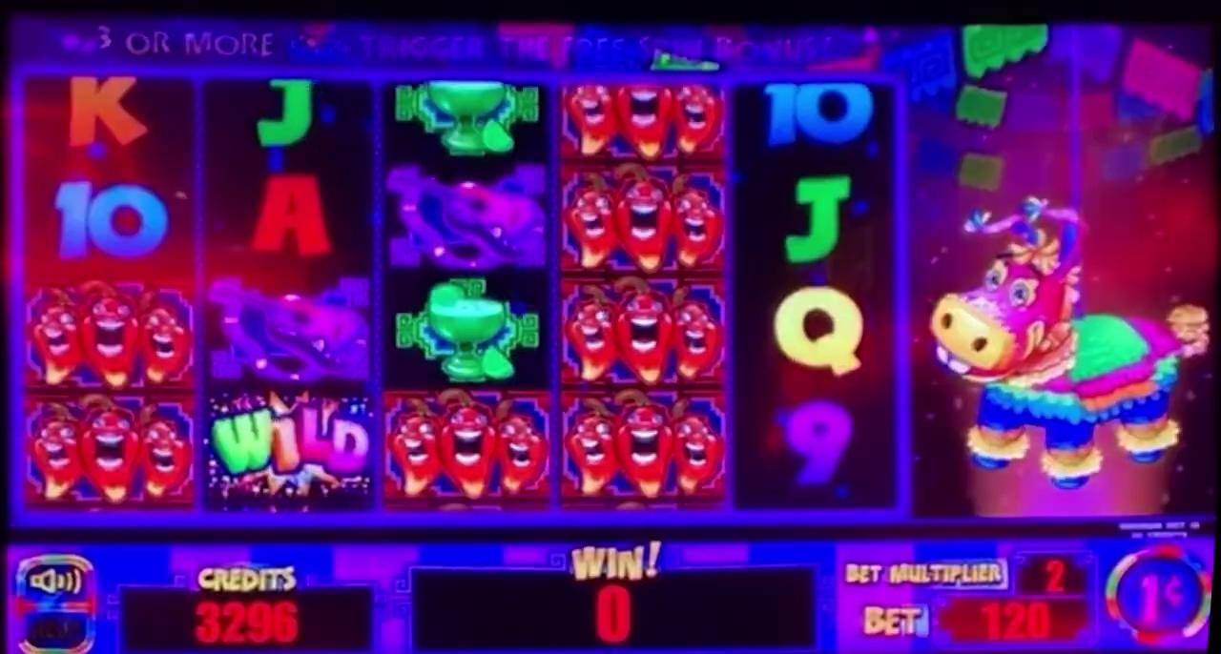
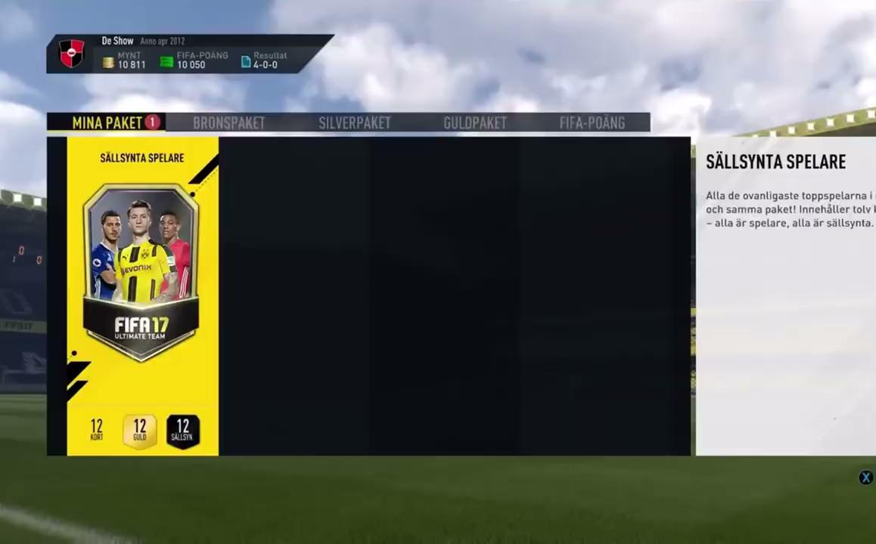
Similarities
“Pinata” slot machine winning game
Cristiano Ronaldo being “packed” in FIFA 17
Effects: bad, bad, bad.
Thank you!

Slide 4
Works Cited
Amani, Malahat. “Psychological Effects of FIFA, PES, and Clash of Clans Games on Young Men at Risk of Developing Internet ______Gaming Disorder.” Addiction and Health, vol. 15, no. 1, Jan. 2023, pp. 31–38. https://doi.org/10.34172/ahj.2023.1344. ______Accessed 12 Nov. 2024.
Carey, Patrick Andrew Kerin, et al. “An Evaluation of Gaming-Related Harms in Relation to Gaming Disorder and Loot Box ______Involvement.” International Journal of Mental Health and Addiction[RR1] , June 2021, pp. 2906-2921, ______https://doi.org/10.1007/s11469-021-00556-5. Accessed 17 Jan . 2025.
Griffiths, Mark D., Daria J. Kuss, and Halley M. Pontes. "A Brief Overview of Internet Gaming Disorder and Its Treatment." Australian ______Clinical Psychologist, vol. 2, no. 1, 2016, article no. 20108, https://irep.ntu.ac.uk/id/eprint/28396/. Accessed 23 Feb. 2025.
King, Daniel L., and Paul H. Delfabbro. “Predatory Monetization Schemes in Video Games (E.g. ‘Loot Boxes’) and Internet Gaming ______Disorder.” Addiction, vol. 113, no. 11, June 2018, pp. 1967–1969, https://doi.org/10.1111/add.14286. Accessed 12 Mar. 2025.
Raneri, Phillip C., et al. “The Role of Microtransactions in Internet Gaming Disorder and Gambling Disorder: A Preregistered ______Systematic Review.” Addictive Behaviors Reports, vol. 15, no. 100415, Feb. 2022, p. 100415, ______https://doi.org/10.1016/j.abrep.2022.100415. Accessed 12 Nov. 2024.
Zendle, David, et al. “Adolescents and Loot Boxes: Links with Problem Gambling and Motivations for Purchase.” Royal Society Open ______Science, vol. 6, no. 190049, June 2019, https://royalsocietypublishing.org/doi/10.1098/rsos.190049. Accessed 17 Jan. 2025.

